Slide 1
FAST FACTS ABOUT… TIRE CARE

Slide 2
Tires are one of the most important safety components of the car and the only part that touches the road and thus critical to road safety. That is why tire care and maintenance should be a top priority for all motorists.
WHY IS TIRE CARE IMPORTANT?
Source: USTMA’s Tire Care Essentials

Slide 3
Play Your P.A.R.T. 1. Check inflation PRESSURE monthly 2. Get ALIGNMENT checked by a car dealer 3. ROTATE your tires 4. Inspect the TREAD of your tires
ESSENTIAL TIRE CARE RECOMMENDATIONS
Source: USTMA’s Tire Care Essentials

Slide 4
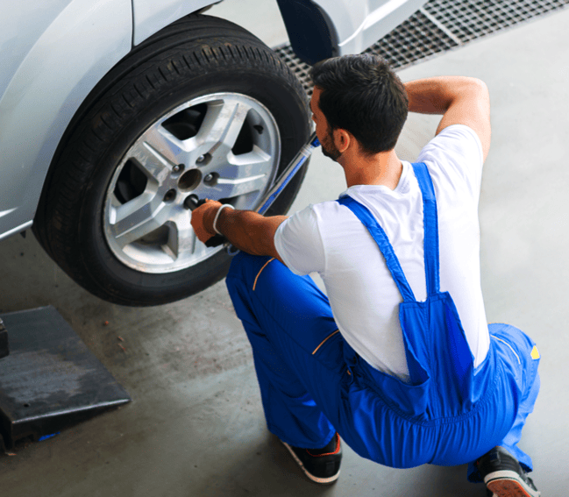
Rotate your tires based on recommendations in your vehicle owner’s manual. If no rotation period is specified, rotate your tires every 5,000 to 8,000 miles.
HOW OFTEN SHOULD YOU ROTATE YOUR TIRES?
Source: USTMA’s Tire Care Essentials

Slide 5
HOW DO YOU CHECK YOUR TIRE TREAD?
Check your tire tread using the penny trick:
Turn a penny upside down and place it in one of your tire’s major grooves.
If part of Lincoln’s head is covered by the tread, you’re good to go.
If you can see all of his head, it’s time for a new tire.
Source: USTMA’s Tire Care Essentials

Slide 6
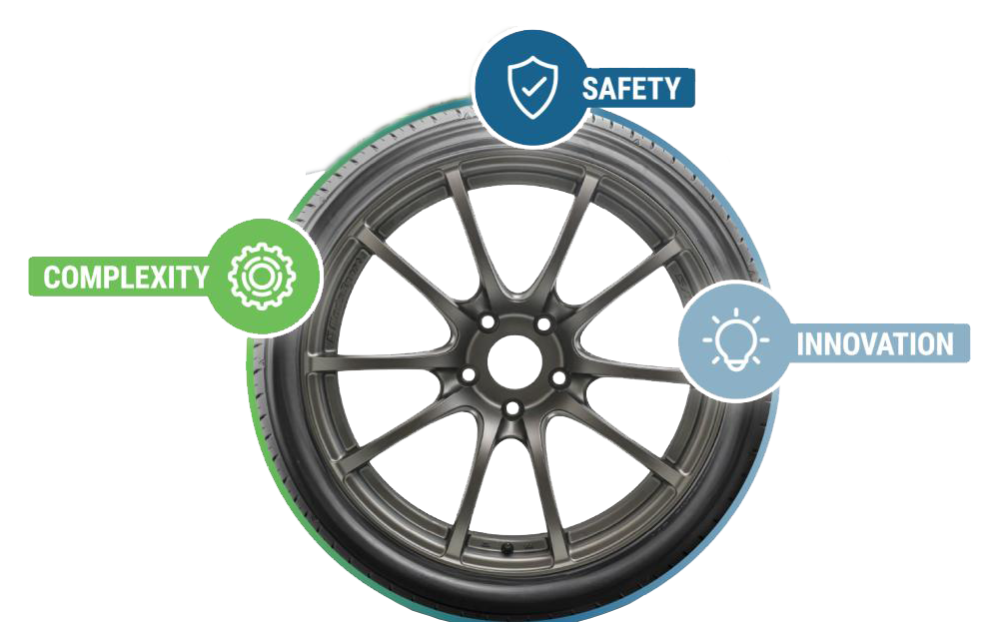
Complexity: Tires are highly engineered and regulated to ensure their safety, quality and durability. Safety: A tire’s grip enables your ability to safely brake, turn and accelerate, safely transporting you to your destination. Innovation: Tires now incorporate dozens of complex components and design features that increase tires’ safety, efficiency and reliability.
PROTECTING WHAT MATTERS MOST
Source: USTMA’s Tire Care Essentials

Slide 7
Today’s advanced tires offer reliability and simplicity. Regular care—such as checking pressure, tread depth and alignment—ensures safety, longevity and peak performance on the road.

Slide 8
LEARN MORE ABOUT TIRE CARE ON USTIRES.ORG.

